Slide 1
TASTER DAY
EXPERIENCE 2020
We are sorry to report that all of our Year 10 taster days for 2020 have been cancelled. Read on for more information about New College Pontefract and we hope to see you soon at one of our Open events

Slide 2
Click HERE
to watch a slide show of photographs for a preview of what life is like at a
Sixth Form College.

Slide 3
In these unprecedented times, we are unable to offer this year's cohort of Y10 students our taster day experience.
Here are some reasons why you should visit one of our Open events in the Autumn term..

Slide 4
1
To help you to make one of the biggest decisions of your life so far:
Where to study Post-16. There are many options out there for you. Please take in to account all factors when making this decision...Location, courses offered, results, the 'feel' you get when visiting.

Slide 5
Because we are... …
2
OUTSTANDING!: Ofsted graded us outstanding in all areas a number of years ago and our results have been improving ever since.

Slide 6
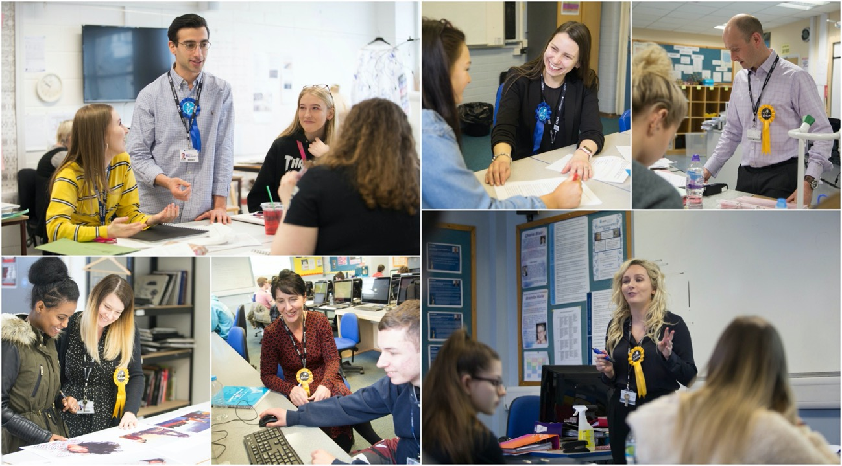
To meet our fantastic, highly qualified, teachers. They are Level 3 experts with the knowledge and skills to help you progress to the next level.
3

Slide 7
To find out about the extensive range of courses we offer;
4
Graphic Design
History
Law
Maths
Further Maths
Media
Music
Photography
Physical Education
Physics
Politics
Psychology
Religion, Ethics & Philosophy
Sociology
Spanish
Textiles & Fashion Design
Accounting
Fine Art
Biology
Business
Chemistry
Computer Science
Dance
Drama & Theatre Studies
Economics
English Language
English Lang & Lit
English Literature
Film Studies
French
Geography
Geology
Art & Design Extended Diploma BTEC
Business Extended Certificate BTEC
Business Diploma BTEC
Business Extended Diploma BTEC
Childcare Diploma CACHE
Creative Media Extended Certificate
Criminology Diploma WJEC
Games Design
Extended Certificate BTEC
Games Design
Extended Diploma BTEC
Health & Social Care
Extended Certificate BTEC
Health & Social Care
Diploma BTEC
Health & Social Care
Extended Diploma BTEC
I.T. Extended Certificate BTEC
I.T. Diploma BTEC
I.T. Extended Diploma BTEC
Law (Applied) Extended Certificate BTEC
Medical Science Diploma WJEC
Music Extended Certificate BTEC
Music Technology Extended Certificate BTEC
Performing Arts (Acting)
Extended Certificate BTEC
Performing Arts (Dance)
Extended Certificate BTEC
Performing Arts Extended Diploma UAL
Photography Extended Certificate BTEC
Psychology (Applied) Extended Certificate BTEC
Public Services Extended Diploma BTEC
Science (Applied) Extended Certificate BTEC
Sport Extended Certificate BTEC
Sport Diploma BTEC
Sport Extended Diploma BTEC

Slide 8
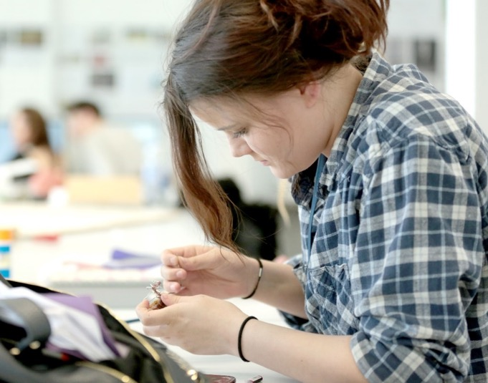
To speak to teachers and find out what the subjects involve; - does the content interest you. - is it going to inspire you to work hard. - is it going to help you progress to where you want to go next.
5

Slide 9
6
To find out exactly what the subject requirements are
For example, did you know to study:
For example, did you know to study:
Psychology: 5 in Maths, 5 in English and 5-5 in combined science
Further Maths: 8 in Maths Accounting: 6 in Maths
Check out the full list of entry requirements Click HERE

Slide 10
To experience the New College environment
7
IT REALLY DOES FEEL LIKE A SIXTH FORM COLLEGE!
Its very different to a school sixth form and equally different to a big FE College.

Slide 11
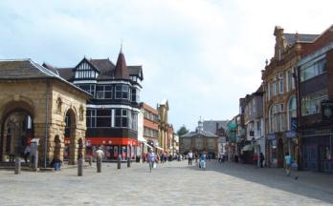
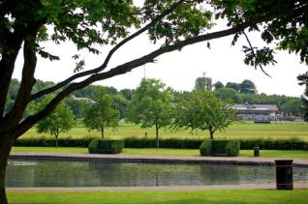
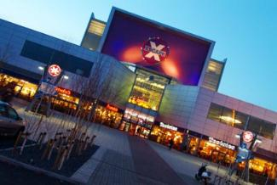
Location We are just behind the racecourse and brand new leisure centre on Park Lane in Pontefract, close to local amenities such as;
8
Pontefract Town Centre
Pontefract Park
Xscape
Junction 32 Outlet

Slide 12
Do not make a blind decision based on friends, brothers or sisters. Do the research yourself and make the right decision for you!
EXPERIENCE
All being well, we will be in school for an assembly during September or October to remind you about what we offer and key dates but keep a close eye on our website and social media for updates.
@ncpontefract ncpontefract.ac.uk

Slide 13
10 FACTS
YOU MAY NOT KNOW ABOUT…

Slide 14
New College is a specialist Sixth Form College exclusive to 16-19 year olds (no year 7s or adult learners!)
2. Achieved outstanding results in 2019:
100% Pass rate
60% of our students achieved A* - B grades
87% achieved A-C grades
BTEC Pass rate 100%
BTEC Distinction rates 92%
New College is currently ranked as one of the very best colleges in the country according to the latest success rate performance table.

Slide 15
4. We have a bespoke tutor programme called the Excellence Academy, supporting students who want to go to the top university in the country.
5. All our sports teams play in the British colleges sports leagues and are all currently in the top division competing at the highest level.
Offers A level, BTECs and GCSE re-sits.
A high percentage of our students progress to University or are successful in employment after studying at New College (92% of our leavers last year progressed further after New College)
Our campus is made up of outstanding modern and state-of-the-art facilities.

Slide 16
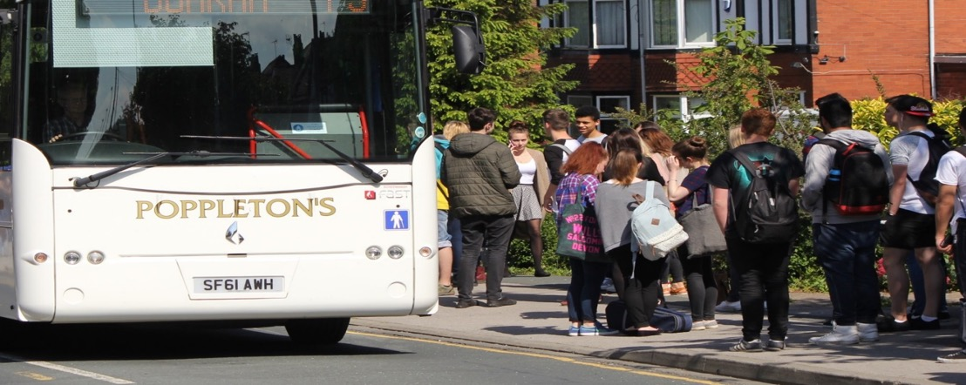
We have been oversubscribed for the last 5 years so you need to apply early next academic year and work hard to achieve good results.
We have our own private (heavily subsidised) bus company to transfer you to and from college in most areas.

Slide 17
Thank you
WE HOPE TO SEE YOU SOON!
Follow us on Facebook, Twitter and Instagram
@ncpontefract
enjoy…succeed…progress

